Slide 1
BELLADONNA
PREPARED BY
DR.SREEJA.S

Slide 2
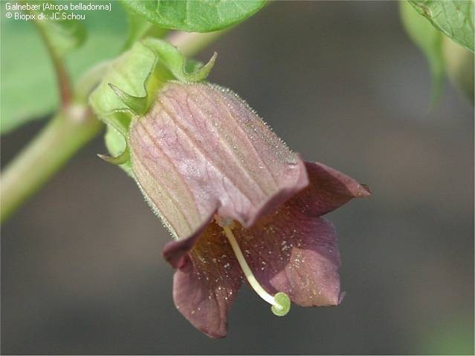
Atropa belladonna:
The deadly nightshade

Slide 3
INTRODUCTION
The word 'Belladonna' is from the Italian 'Bella' whose meaning is 'beautiful' and 'donna' means 'lady'. Belladonna is one of Hahnemann’s polychrests which has it paramount utility in ACUTE AND VIOLENT CONDITIONS. The juice of the berry when placed in the eyes sparkles giving a striking appearance. S

Slide 4
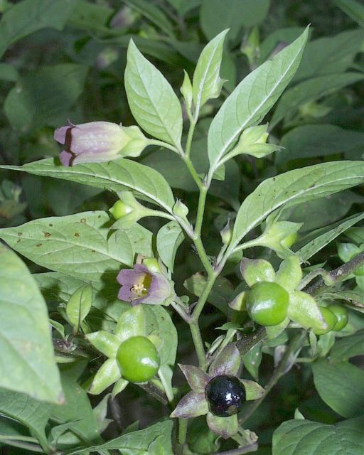
Taxonomy
Kingdom: Plantae
Class: Magnoliophyta
Order: Solanales
Family: Solanaceae
Genus: Atropa
Species: A. belladonna

Slide 5
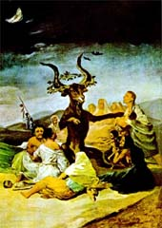
Taxonomy (cont.)
Atropa
From the Greek God Atropos
One of the fates that cut the thread of life
Belladonna
“Beautiful Lady” in Italian
Common Names:
Deadly Nightshade
Devil’s Herb
Apples of Sodom
Same family as the potatoes, tomatoes, eggplants, tobacco, chili peppers, etc.

Slide 6
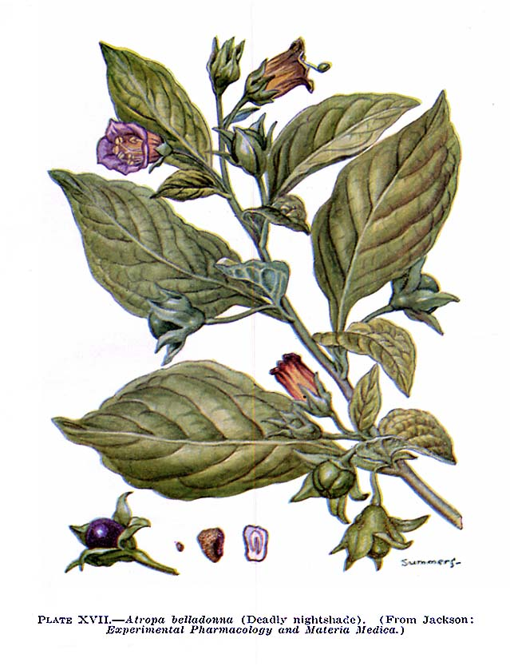
Morphology & Botanical Relationships
Low growing perennial herb/shrub that grows 2-6 ft tall
Not hardy perennial
Sensitive to being transplanted
Thick root
Leaves
Simple, alternate

Slide 7
Morphology & Botanical Relationships (cont.)
Flowers
Solitary bell-shaped (drooping and tubular)
5-lobe
Dull red-purple or greenish purple
Fruit
Glossy, purple-black berries
Green berries turn purplish-black as plant matures

Slide 8
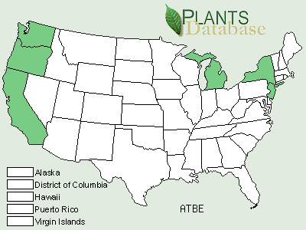
Species Distribution
Native to Eurasia
Naturalized in many parts of the world
Cultivated/harvested in US:
California, Oregon, Washington, Michigan, New Jersey, New York
Some farms even export to Europe

Slide 9
Habitat
Seeds are small: about 10,000 plants will germinate from 1-2oz of seed
Germination takes up to several weeks
In warm, moist, sterile soil
Plant requires:
rich, moist
plenty of fertilizer
weed free environment

Slide 10
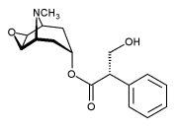
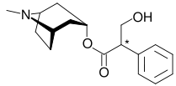
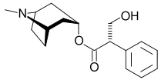
Active Compounds
Tropane Alkaloids
Atropine Hyoscyamine Scopolamine
C₁₇H₂₃NO₃ C₁₇H₂₃NO₃ C₁₇H₂₁NO₄

Slide 11
constituents
A major constituent is atropine. It also has apoatropine, 1-hyo-scyamine, scopolamine, belladonnine, β-methyl-aesculitine, choline, various bitter cucurbitacins, pyridine, N-methyle pyrraline & N-methyl pyrroldine.

Slide 12
History of Uses
Romans used plant as a “weapon”
Contaminated enemies food storage
Used to poison the troops of Marcus Antonius during the Parthian Wars.
Scottish troops used it during a truce to subdue the invading Danes.
Legend: Scottish troops put belladonna into enemies’ liquor supply
Waited for enemies to fall asleep and then kill them

Slide 13
History of Uses (cont.)
“Truth serum” in the old days
Used in many legal battles and court cases
Cosmetics:
Spanish and Italian Women
Extracts used as eye drops to dilate pupils, giving pupils a more intense, hypnotic, and attractive appeal
Because pupil dilate when people are aroused; therefore, making eye contact more intense

Slide 14
History of Uses (cont.)
Pain reducer:
1992: Scopolamine added to morphine to cause “twilight sleep”
Lessened the pain and mortality of childbirth
Life saver:
In 1943 (WWII), the Germans had developed a nerve gas in which Atropa (atropine) was the only antidote
In Tijuana Mexico (1967), people poisoned by insecticide – parathion - when they ate the bread that was exposed to the chemical
Use of atropine saved many lives

Slide 15
Uses in Medicine
Slows action of smooth muscle system
Parkinson’s symptoms
Irregularities in heart rate
Dilates pupils
Reduces salivation
Stomach and bladder
cramps
Helps to relax pre-surgery patients

Slide 16
Uses in Medicine Cont.
Combats infection and decreases pain when combined with methylene blue, phenyl salicylate, and benzoic acid.
Prevents nausea and vomiting caused by motion sickness
Counteracts the effects of nerve gas.

Slide 17
DRUG ACTION
Mydriatic
Antispasmodic
Narcotic
Anaesthetic
Analgesic
Antipyretic
Diaphoretic
Vasodilator

Slide 18
Physiological action
Stimulation of sympathetic nervous system.
Atropine acts on parasympathetic nervous system and produces dilatation of pupils, dryness of mouth, congestion of head, palpitation and hypertension.

Slide 19
Sphere of action
Its chief center of action is cerebrum where it radiates its influence upon the entire organism. Brain and its membranes, cardio-vascular system, heart, lungs, mucus membrane of eyes, mouth, throat, skin, glandular structures also not spared.

Slide 20
Cerebrospinal Nervous system
Acute violent congestion producing throbbing headache, delirium, vertigo, flushed face
Illusions with flashes of many coloured light
Mind agitated with loss of sleep
Atropine paralyses the motor nerves
Convulsions

Slide 21
Heart and Circulatory system
Cardiac inhibitory centers are stimulated
Capillaries contracted
Full and bounding pulse
Atropine raises arterial blood pressure

Slide 22
Temperature & Respiratory System
Atropine in moderate doses raises temperature by 1-3 degree Celsius
In large doses decreases body temperature
Atropine stimulate the respiratory center and increases respiratory rate

Slide 23
GIT and GUT
Decreases the secretion of gastric glands
Retard the peristaltic movements of intestine
Spasm and paralysis of sphincter ani
Produces congestion of malpigian circulation with urine output initially increases and later on suppressed

Slide 24
Female sexual organs
Congestion and increased arterial tension in ovaries and uterus
Sudden spasmodic pain and contraction in uterus with pressure downward as if all the contents of the abdomen would come through vulva
Arrests the secretion of mammary gland

Slide 25
Suppresses the secretion of glands
First increases sweat and later suppresses
Skin red, dry and hot
Eyes – Dilates the pupil, produces conjunctivitis, increases intra ocular tensionssssss

Slide 26
Signs of Overdose
Stop perspiring
Rise in body temperature
Inability to see or blurred vision
Hallucinations
Flushed skin
Confusion
Coma
Death

Slide 27
CONSTITUTION
It is particularly suited to:
• Adapted to bilious, lymphatic, plethoric constitutions; persons who are lively and entertaining when well, but violent and often delirious when sick.

Slide 28
KEY FEATURES
Congestion is the keynote of belladonna.
• Redness of belladonna is very characteristic.
• Heat is yet another peculiar. Due to the congestion there is great heat, especially at the congested and inflamed part.

Slide 29
• Burning sensation is another characteristic of belladonna. There is intense burning anywhere and everywhere, both internal and external such as in skin, brain, mouth, throat, etc.

Slide 30
The patient is very much sleepy but cannot sleep.
• Belladonna is a great pain remedy.
• Patient is not thirsty, especially in fever
Belladonna patients aggravated by touch jar and motion, drought of air and heat of sun

Slide 31
• Sensitiveness to touch of affected part is very well marked in this great remedy. Cannot bear to be touched anywhere.
• Great dryness runs through the whole of this remedy.
• Acute, sudden and violent onset is very characteristic of this drug.

